Slide 1

The Future of ASP.NET: ASP.NET 5, aka vNext
Keith Telle
Senior Software Engineer
Bit Wizards

Slide 2
Gulf Coast DOTNET User Group February 16, 2016
http://www.gulfcoastdotnet.org
@GCDNUG

Slide 3
What is vNext?
Cloud-optimized versions of MVC, Web API, Web Pages, SignalR, and Entity Framework
MVC, Web API, and Web Pages will be merged into one framework, called MVC 6
MVC 6 has no dependency on System.Web
a leaner framework, with faster startup time and lower memory consumption
vNext is host agnostic
host your app in IIS, or self-host in a custom process

Slide 4
What is vNext?
Dependency injection is built into the framework
Use your preferred IoC container to register dependencies
vNext uses the Roslyn compiler to compile code dynamically
edit a code file, refresh the browser, and see the changes without rebuilding the project
vNext is open source and cross platform

Slide 5
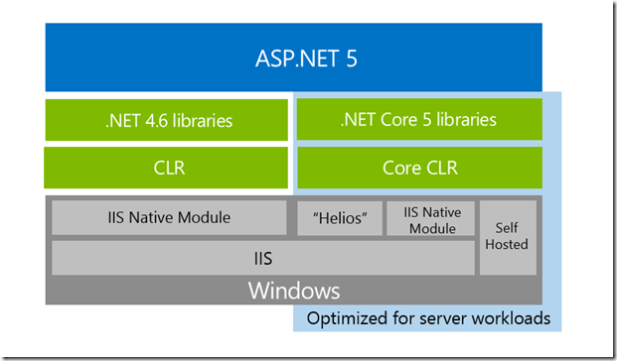
What is ASP.NET 5?

Slide 6
What is ASP.NET 5?
Architectural changes to make the core framework much leaner
No longer based on System.Web.dll
Based on a set of granular and well factored NuGet packages

Slide 7
What is ASP.NET 5?
A unified story for building Web UI and Web APIs that integrate with today’s modern client-side frameworks and development workflows
Supports cross-platform development on Windows, Mac and Linux
A new, agile project system in Visual Studio while also providing a complete command-line interface so that you can develop using the tools of your choice

Slide 8
What is ASP.NET 5?
New light-weight and modular HTTP request pipeline
Ability to host on IIS or self-host in your own process
Built on .NET Core, which supports true side-by-side app versioning
Ships entirely as NuGet packages

Slide 9
What is ASP.NET 5?
Integrated support for creating and using NuGet packages
Single aligned web stack for Web UI and Web APIs
Cloud-ready environment-based configuration
Built-in support for dependency injection

Slide 10
What is ASP.NET 5?
New tooling that simplifies modern web development
Build and run cross-platform ASP.NET apps on Windows, Mac and Linux
Open source and community focused

Slide 11
Application Anatomy
.NET Execution Environment (DNX)
ASP.NET 5 applications are defined using a public Startup class

Slide 12
Startup.cs
1 2 3 4 5 6 7 8 9 10 11 12 | public class Startup { public void ConfigureServices(IServiceCollection services) { } public void Configure(IApplicationBuilder app) { } public static void Main(string[] args) => WebApplication.Run<Startup>(args); }

Slide 13
Services
A service is a component that is intended for common consumption in an application
Services are made available through dependency injection
ASP.NET 5 includes a simple built-in inversion of control (IoC) container that supports constructor injection by default
can be easily replaced with your IoC container of choice

Slide 14
Middleware
ASP.NET 5 middleware perform asynchronous logic on an HttpContext
optionally invoke the next middleware in the sequence or terminate the request directly
You generally “Use” middleware by invoking a corresponding extension method on the IApplicationBuilder in your Configure method
Ships with a rich set of pre-built Middleware
Working with Static Files
Routing
Diagnostics
Authentication

Slide 15
Middleware
You can also author your own custom middleware.
You can use any OWIN-based middleware with ASP.NET 5

Slide 16
Servers
ASP.NET Application Hosting model does not directly listen for requests
Relies on an HTTP server implementation to surface the request to the application
A set of feature interfaces that can be composed into an HttpContext
Includes server support for running on IIS or self-hosting in your own process

Slide 17
Servers
On Windows you can host your application outside of IIS using the WebListener server, which is based on HTTP.sys
You can also host your application on a non-Windows environment using the cross-platform Kestrel web server

Slide 18
Web Root
The Web root of your application is the root location in your project from which HTTP requests are handled
The Web root of an ASP.NET 5 application is configured using the “webroot” property in your project.json file

Slide 19
Configuration
Uses a new configuration model for handling of simple name-value pairs that is not based on System.Configuration or web.config
New configuration model pulls from an ordered set of configuration providers
Built-in configuration providers support a variety of file formats (XML, JSON, INI) and also environment variables to enable environment-based configuration
Write your own custom configuration providers

Slide 20
Client-side Development
ASP.NET 5 is designed to integrate seamlessly with a variety of client-side frameworks
AngularJS
KnockoutJS
Bootstrap

Slide 21
What is .NET Core?
A modular runtime and library implementation that includes a subset of the .NET Framework
Consists of a set of libraries, called “CoreFX”, and a small, optimized runtime, called “CoreCLR”
The CoreCLR runtime (Microsoft.CoreCLR) and CoreFX libraries are distributed via NuGet

Slide 22
What is .NET Core?
The CoreFX libraries are factored as individual NuGet packages according to functionality, named “System.[module]” on nuget.org
You can package and deploy the CoreCLR with your application, eliminating your application’s dependency on an installed version of .NET (Portability)

Slide 23
What is .NET Core?
You can host multiple applications side-by-side using different versions of the CoreCLR
Upgrade them individually, rather than being forced to upgrade all of them simultaneously
CoreFX has been built as a componentized set of libraries, each requiring the minimum set of library dependencies
System.Collections only depends on System.Runtime, not System.Xml

Slide 24
What is .NET Core?
Enables minimal distributions of CoreFX libraries
Allows developers to target a single common set of libraries that are supported by multiple platforms

Slide 25
What is the .NET Execution Environment?
The .NET Execution Environment (DNX) is a software development kit (SDK) and runtime environment that has everything you need to build and run .NET applications for Windows, Mac and Linux
It provides a host process, CLR hosting logic and managed entry point discovery
DNX was built for running cross-platform ASP.NET Web applications, but it can run other types of .NET applications, too, such as cross-platform console apps

Slide 26
Why build DNX?
Cross-platform .NET development
A consistent development and execution environment across multiple platforms
Develop your application on one platform and run it on a different platform
Built for .NET Core
Dramatically simplifies the work needed to develop cross-platform applications using .NET Core
Takes care of hosting the CLR, handling dependencies and bootstrapping your application
Easily define projects and solutions using a lightweight JSON format (project.json)

Slide 27
Why build DNX?
Package ecosystem
Easy to create and consume packages
Provides tools for installing, creating and managing NuGet packages
DNX projects simplify building NuGet packages by cross-compiling for multiple target frameworks and can output NuGet packages directly
Reference NuGet packages directly from your projects and transitive dependencies are handled for you
Build and install development tools as packages for your project and globally on a machine
Open source friendly
Easily replace an existing dependency with its source code and let DNX compile it in-memory at runtime
Debug the source and modify it without having to modify the rest of your application

Slide 28
Projects
A DNX project is a folder with a project.json file
Name of the project is the folder name
project.json file defines your package metadata, your project dependencies and which frameworks you want to build for

Slide 29
project.json
1 2 3 4 5 6 7 8 9 10 11 12 13 14 15 16 17 18 19 20 21 | { "version": "1.0.0-*", "description": "ClassLibrary1 Class Library", "authors": [ "daroth" ], "tags": [ "" ], "projectUrl": "", "licenseUrl": "", "frameworks": { "net451": { }, "dotnet5.4": { "dependencies": { "Microsoft.CSharp": "4.0.1-beta-23516", "System.Collections": "4.0.11-beta-23516", "System.Linq": "4.0.1-beta-23516", "System.Runtime": "4.0.21-beta-23516", "System.Threading": "4.0.11-beta-23516" } } } }

Slide 30
Projects
All the files in the folder are by default part of the project unless explicitly excluded in project.json
You can also define commands as part of your project that can be executed
You can use the .NET Development Utility (DNU) to build, package and publish DNX projects

Slide 31
Projects
Building a project produces the binary outputs for the project
Packaging produces a NuGet package that can be uploaded to a package feed
Publishing collects all required runtime artifacts (the required DNX and packages) into a single folder so that it can be deployed as an application

Slide 32
Dependencies
Dependencies in DNX consist of a name and a version number
Typically dependencies refer to an installed NuGet package or to another DNX project
Project references are resolved using peer folders to the current project or project paths specified using a global.json file at the solution level

Slide 33
global.json
1 2 3 4 5 6 | { "projects": [ "src", "test" ], "sdk": { "version": "1.0.0-rc1-final" } }

Slide 34
Dependencies
The global.json file also defines the minimum DNX version (“sdk” version) needed to build the project
Dependencies are transitive in that you only need to specify your top level dependencies
DNX will handle resolving the entire dependency graph for you using the installed NuGet packages
Project references are resolved at runtime by building the referenced project in memory

Slide 35
Packages and Feeds
For package dependencies to resolve they must first be installed
You can use DNU to install a new package into an existing project or to restore all package dependencies for an existing project
dnu restore

Slide 36
Commands
A command is a named execution of a .NET entry point with specific arguments
You can define commands in your project.json file
You can then use DNX to execute the commands defined by your project
dnx web
1 2 3 4 | "commands": { "web": "Microsoft.AspNet.Server.Kestrel", "ef": "EntityFramework.Commands" },

Slide 37
Application Host
The DNX application host is typically the first managed entry point invoked by DNX and is responsible for handling dependency resolution, parsing project.json, providing additional services and invoking the application entry point
Alternatively, you can have DNX invoke your application’s entry point directly
Requires that your application be fully built and all dependencies located in a single directory

Slide 38
Compile Modules
Compile modules are an extensibility point that let you participate in the DNX compilation process
You implement a compile module by implementing the ICompileModule interface and putting your compile module in a compiler/preprocess or compiler/postprocess in your project

Slide 39
DNX Version Manager
You can install multiple DNX versions and flavors on your machine
To install and manage different DNX versions and flavors you use the .NET Version Manager (DNVM)
DNVM lets you list the different DNX versions and flavors on your machine, install new ones and switch the active DNX

Slide 40
Demonstration
Creating a Cross-Platform Console App with DNX

Slide 41
Demonstration
Creating a Cross-Platform Web App with DNX

Slide 42
Questions

Slide 43
Upcoming
Next Meeting
Tuesday, March 15, 2016 @ 6:00 PM
Building Projects on Raspberry PI and Windows 10 core IoT
Matthew Perry-Hill

Slide 44
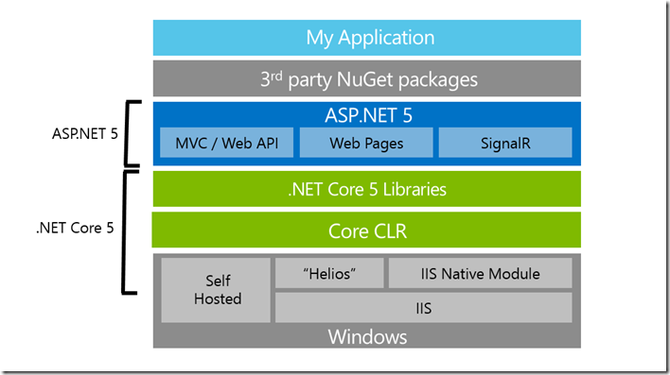
Extras

Slide 45
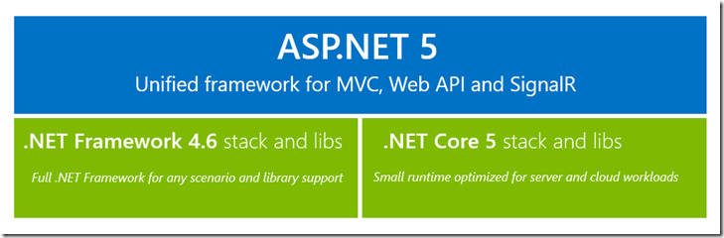
Extras

Slide 46
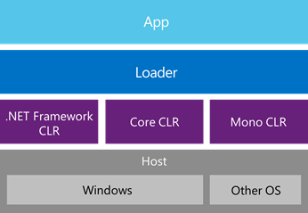
Extras

